Slide 1
Deterministic Particle Transport for Thermal Radiative Transfer
Benji Estrada
2/15/2025

Slide 2
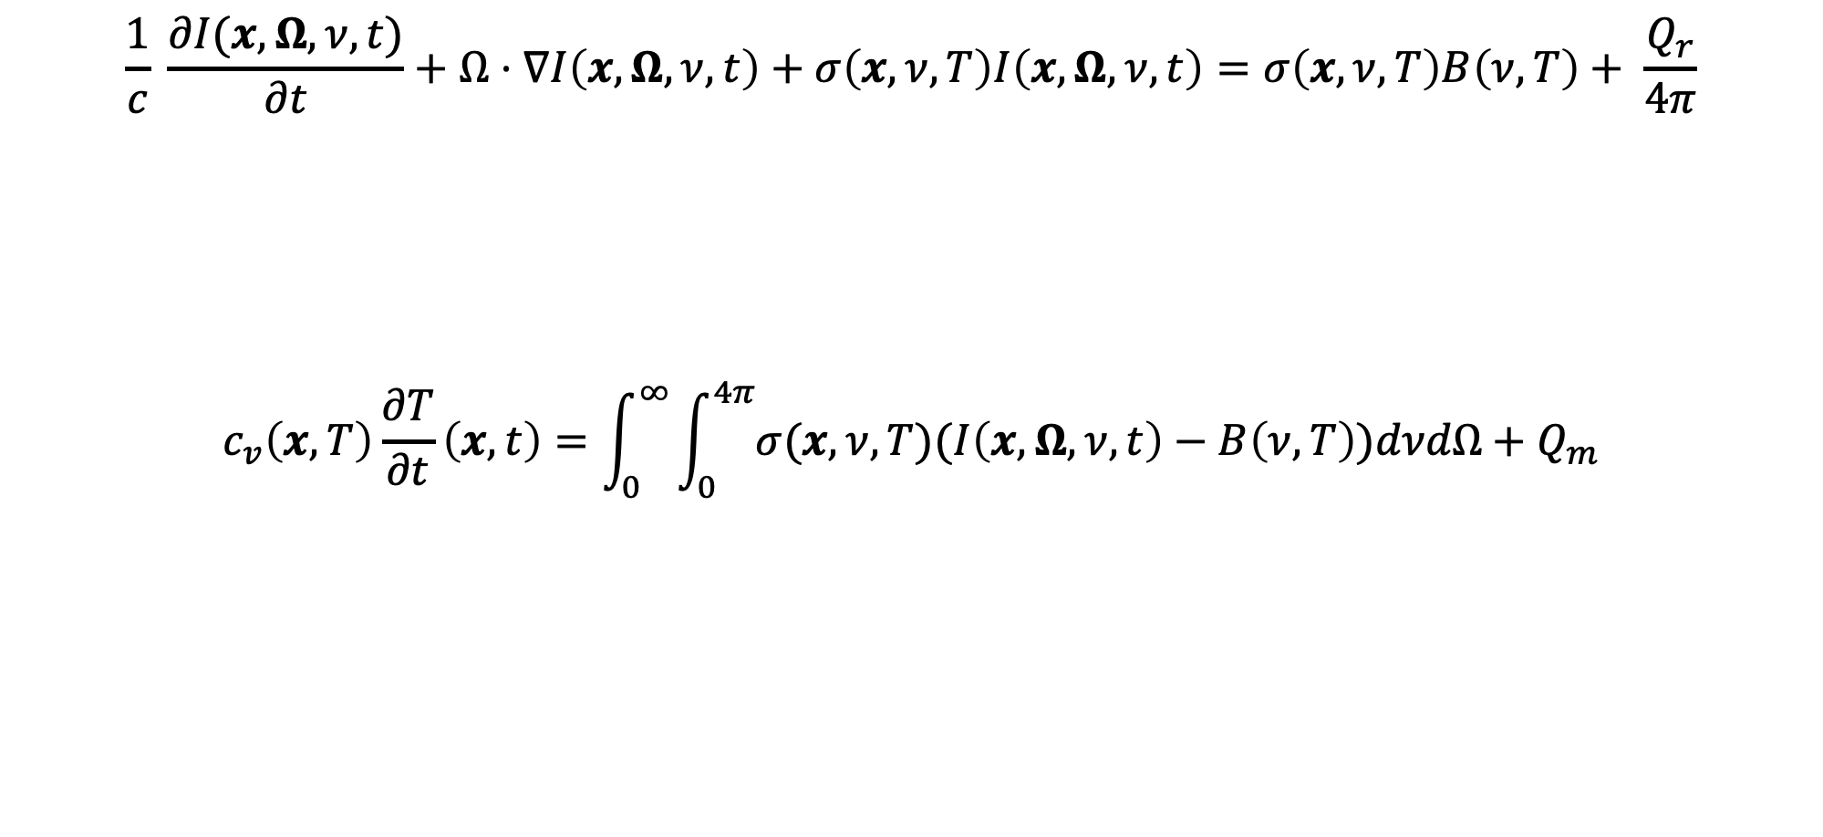
Some basics on TRT
Temporal streaming
Spatial streaming
Collisional Absorption
Thermal Emission
Ext. Source
$$\frac{1}{c} \frac{∂I(x,Ω,ν, t)}{∂t}+Ω⋅∇I\left(x,Ω, ν, t\right)+σ\left(x,ν,T\right)I\left(x,Ω,ν,t\right)=σ\left(x,ν,T\right)B\left(ν, T\right)+ \frac{Q_{r}}{4π}$$
$$c_{v}\left(x,T\right)\frac{∂T}{∂t}\left(x,t\right)=\int_{0}^{∞}{\int_{0}^{4π}{σ(x,ν,T)(I\left(x,Ω,ν,t\right)−B\left(ν,T\right))dνdΩ+Q_{m}}}$$
Rate of Energy Change
Absorption and Thermal Emission
Ext. Source

Slide 3
Implicit Monte Carlo
Developed by Fleck and Cummings to provide a Monte Carlo solution to the linearized TRT equations.
The de-facto standard for radiative transfer transport solutions.

Slide 4
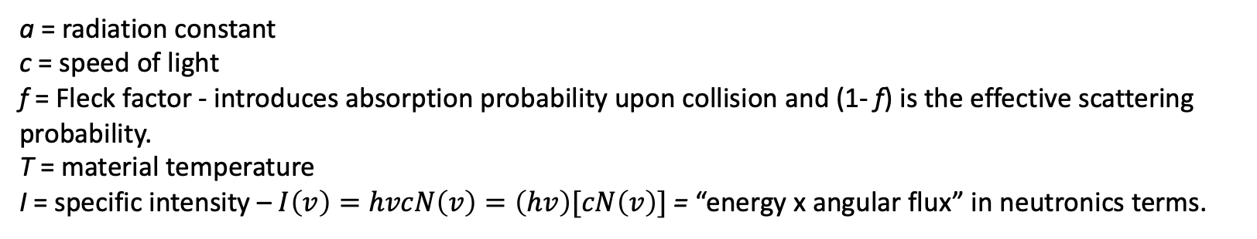
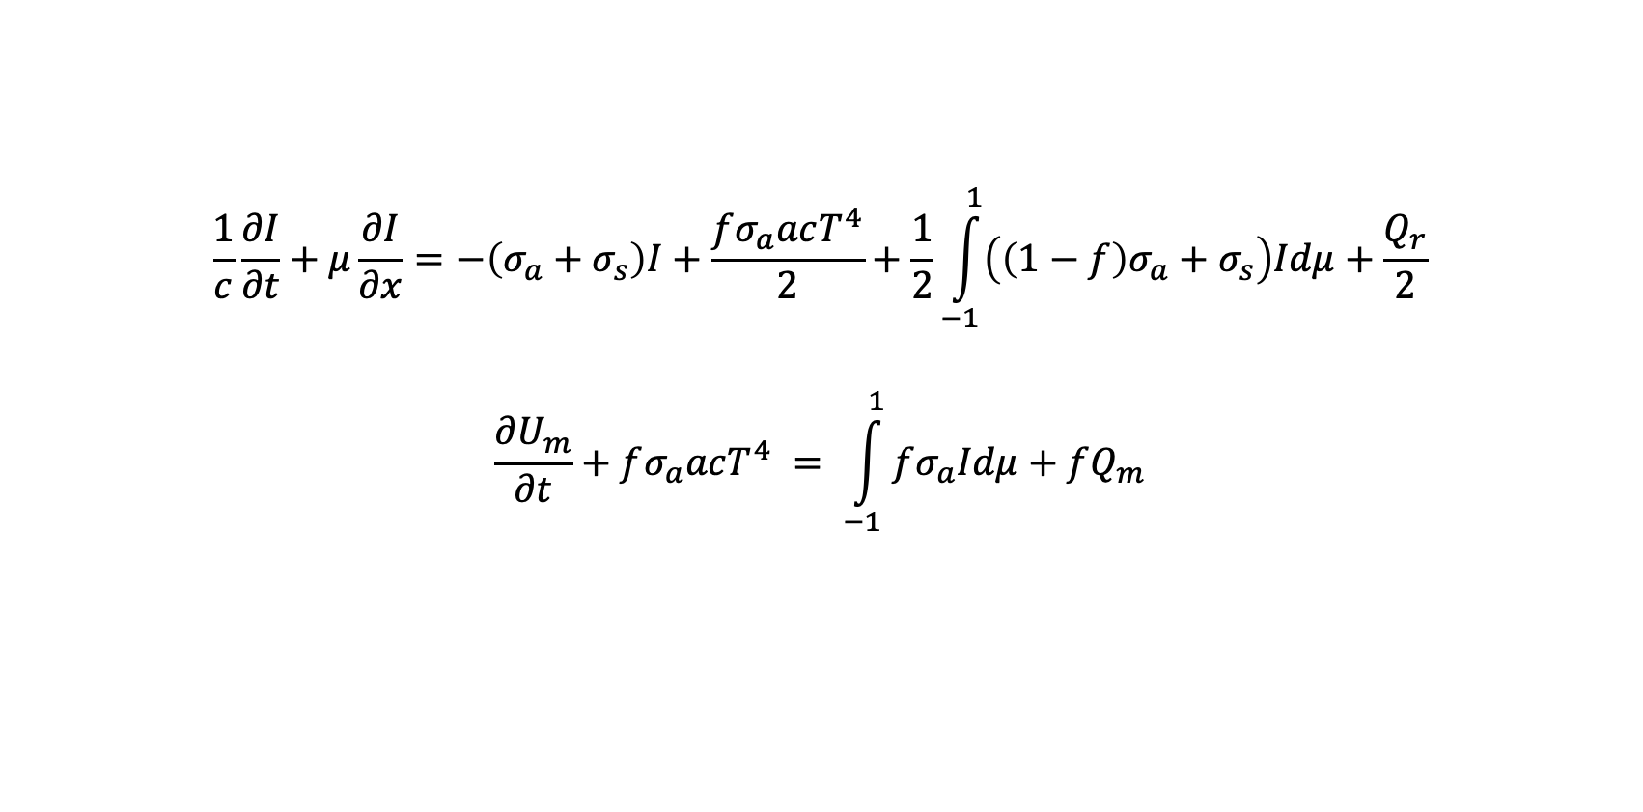
The 1D Gray Linearized TRT Equations
$$\frac{1}{c}\frac{∂I}{∂t}+μ\frac{∂I}{∂x}=−\left(σ_{a}+σ_{s}\right)I+\frac{fσ_{a}acT^{4}}{2}+\frac{1}{2}\int_{−1}^{1}{\left(\left(1−f\right)σ_{a}+σ_{s}\right)Idμ}+\frac{Q_{r}}{2}$$
$$\frac{∂U_{m}}{∂t}+fσ_{a}acT^{4} = \int_{−1}^{1}{fσ_{a}Idμ}+fQ_{m}$$
a = radiation constant
c = speed of light
f = Fleck factor - introduces absorption probability upon collision and (1- f) is the effective scattering probability.
T = material temperature
I = specific intensity – $I\left(v\right)=hvcN\left(v\right)=\left(hv\right)[cN\left(v\right)]$ = “energy x angular flux” in neutronics terms.

Slide 5
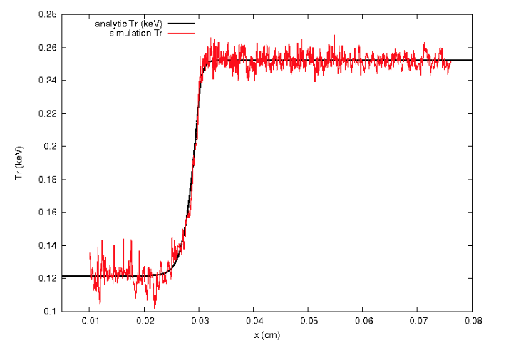
Why do we want to do deterministic transport?
Multiphysics codes solve the radiation and fluids separately.
Noise can seed hydrodynamic instabilities.

Slide 6
Our goal
Develop a Monte Carlo code (particles, tallies, weights) that doesn’t use random numbers.
RNs get used in sourcing, scattering, and population control.

Slide 7
Sourcing
In IMC, particles our sourced uniformly and continuously in the phase space. For a surface-source, the angular distribution is not uniform though.
In DPT, we will have to use uniform discrete values that span the same PDFs as in IMC.

Slide 8
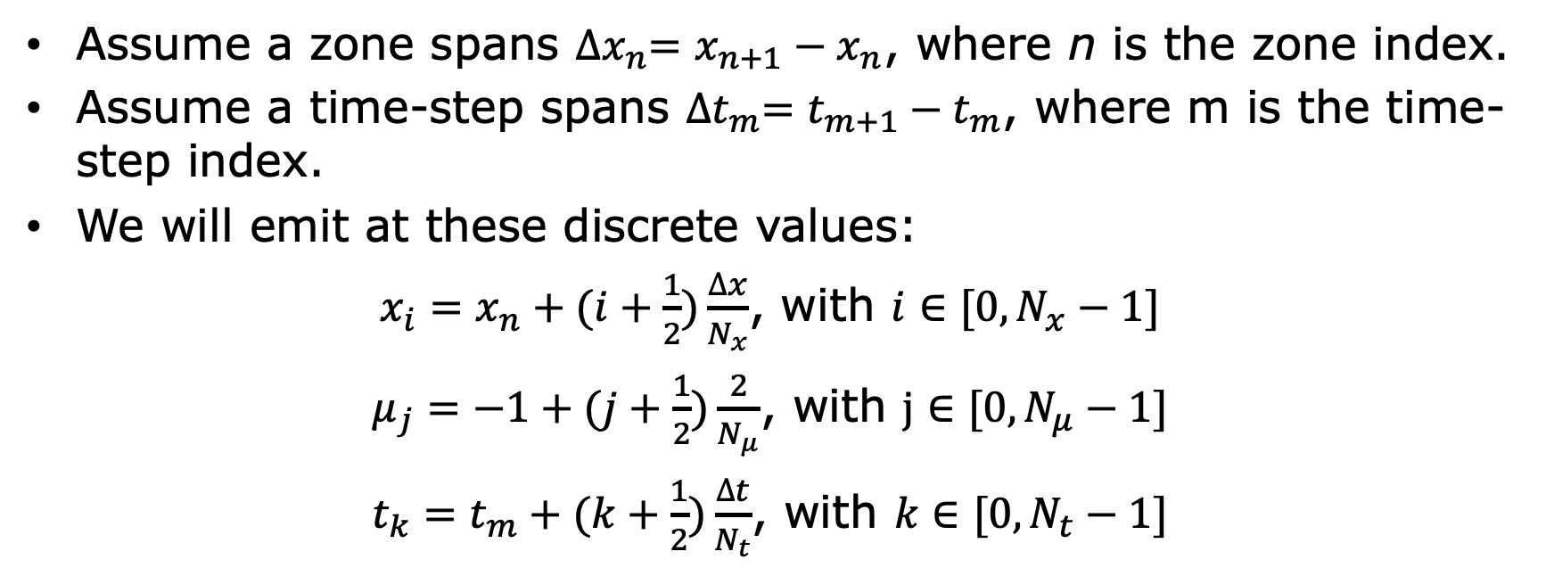
Body-Source Particles
Assume a zone spans ${∆x}_{n}=x_{n+1}−x_{n}$, where n is the zone index.
Assume a time-step spans ${∆t}_{m}=t_{m+1}−t_{m}$, where m is the time-step index.
We will emit at these discrete values:
$x_{i}=x_{n}+(i+\frac{1}{2})\frac{∆x}{N_{x}}$, with $i∈[0,N_{x}−1]$
$μ_{j}=−1+(j+\frac{1}{2})\frac{2}{N_{μ}}$, with $j∈[0,N_{μ}−1]$
$t_{k}=t_{m}+(k+\frac{1}{2})\frac{∆t}{N_{t}}$, with $k∈[0,N_{t}−1]$

Slide 9
Sourcing
We show the distribution of emitted particles in space and angle in a unit cell.

Slide 10
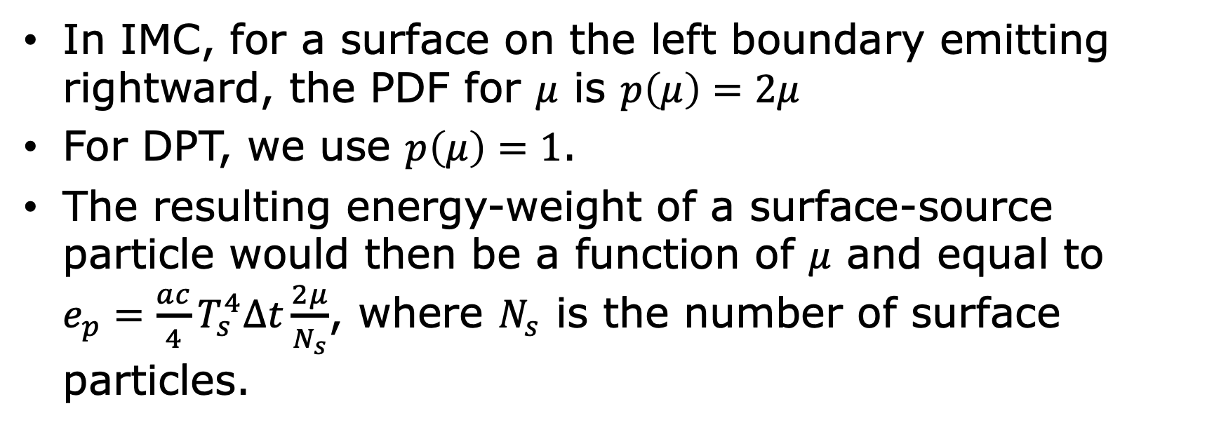
Surface Source Particles
In IMC, for a surface on the left boundary emitting rightward, the PDF for $μ$ is $p\left(μ\right)=2μ$
For DPT, we use $p\left(μ\right)=1$.
The resulting energy-weight of a surface-source particle would then be a function of $μ$ and equal to $e_{p}=\frac{ac}{4}T_{s}^{4}∆t\frac{2μ}{N_{s}}$, where $N_{s}$ is the number of surface particles.

Slide 11
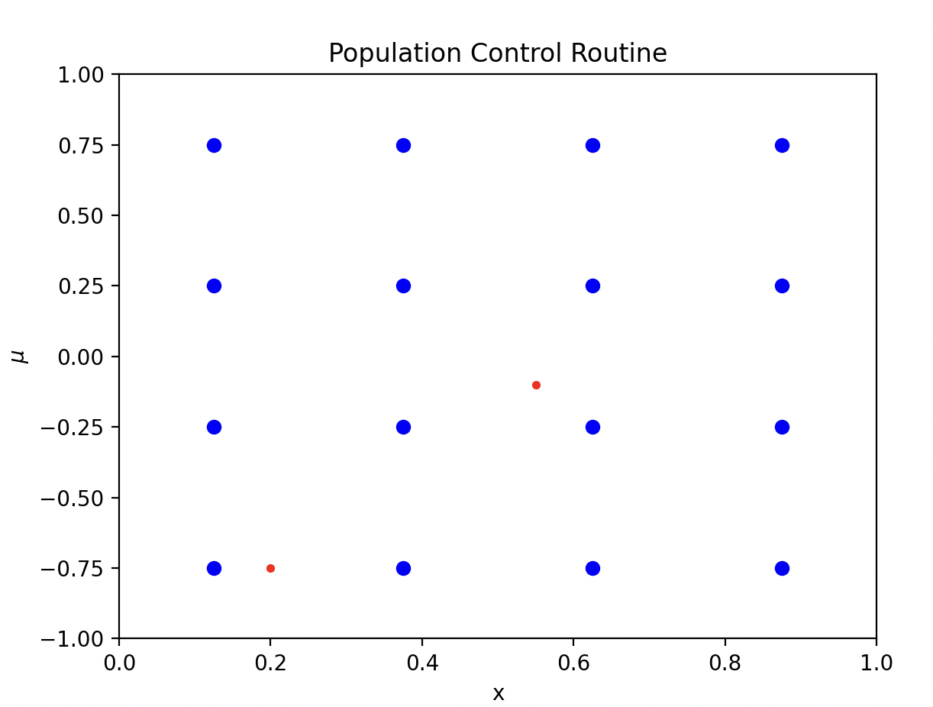
Population Control
The blue particles are the particles that will be emitted in the next time-step.
The red particle’s energy will be re-mapped to the closest grid point

Slide 12
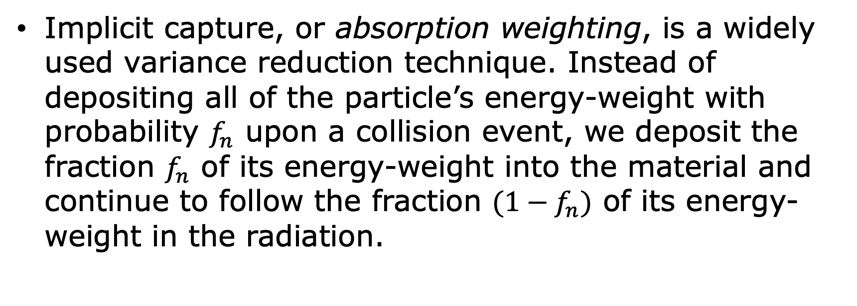
A note on Implicit Capture
Implicit capture, or absorption weighting, is a widely used variance reduction technique. Instead of depositing all of the particle’s energy-weight with probability $f_{n}$ upon a collision event, we deposit the fraction $f_{n}$ of its energy-weight into the material and continue to follow the fraction $(1−f_{n})$ of its energy-weight in the radiation.

Slide 13
A note on Implicit Capture
We get better statistics at the cost of longer histories.
Very helpful in radiative transfer, because we often want global or semi-global answers.
Some of the math behind this will help us tackle scattering.
Fun fact: this is the default treatment for particles in MCNP.

Slide 14
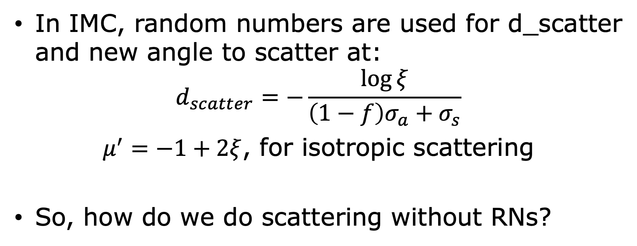
IMC Scattering
In IMC, random numbers are used for d_scatter and new angle to scatter at:
$$d_{scatter}=−\frac{\log{ξ}}{\left(1−f\right)σ_{a}+σ_{s}}$$
$μ^{′}=−1+2ξ$, for isotropic scattering
So, how do we do scattering without RNs?

Slide 15
Implicit Scattering
This will be analogous to implicit capture; we will remove scattering events from the collision kernel. If we are using both implicit capture and scattering, then particles will no longer undergo collisions.

Slide 16
Implicit Scattering
We have to do something with that scattered energy.
We will make more particles and do some heavy math to figure out where to put those particles and put a distribution on the scattered energy in space and time.

Slide 17
Numerical Results

Slide 18
Su-Olson Benchmark
1-D, half-space, non-equilibrium problem in an isotropically scattering medium.
Material starts cold and unit radiation source is turned on.
For the IMC solution, the following parameters were used: 1000 cycles with Δ𝑡 = 0.01, Δ𝑥 = 0.05, and 1000 source particles per time-step.
For the DPT solution, the following parameters were used: 1000 cycles with Δ𝑡 = 0.01, Δ𝑥 = 0.05, and 𝑁𝑥 = 3, 𝑁𝜇 = 8, 𝑁𝑡 = 3.

Slide 19
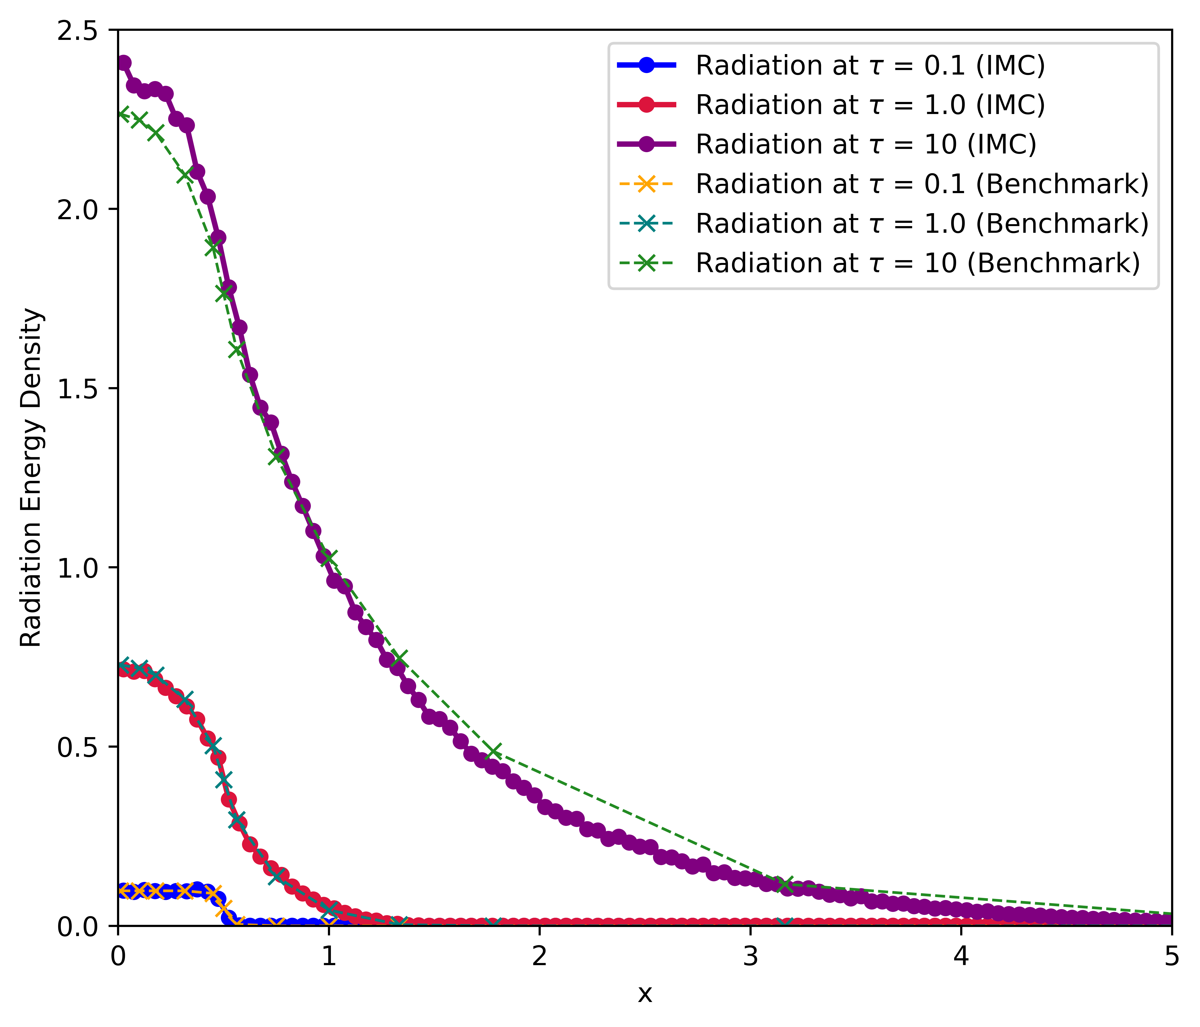
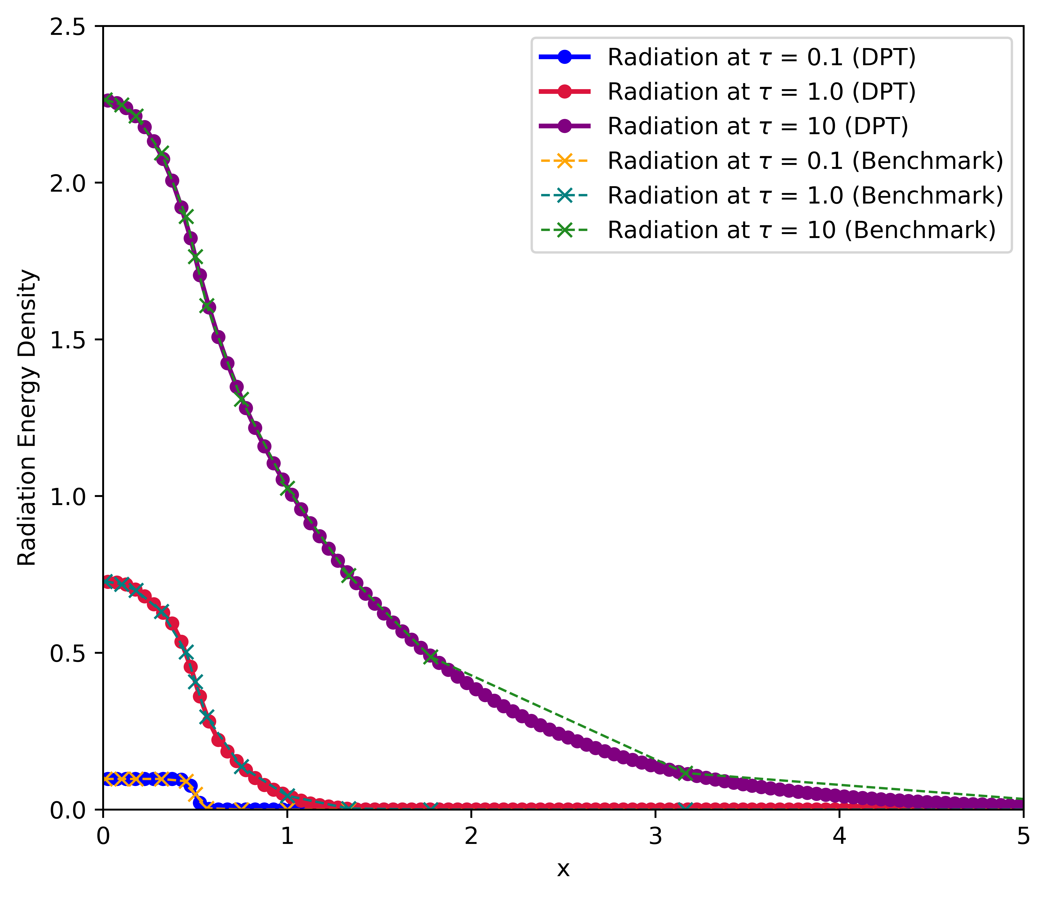
Radiation Energy Density – IMC vs DPT

Slide 20
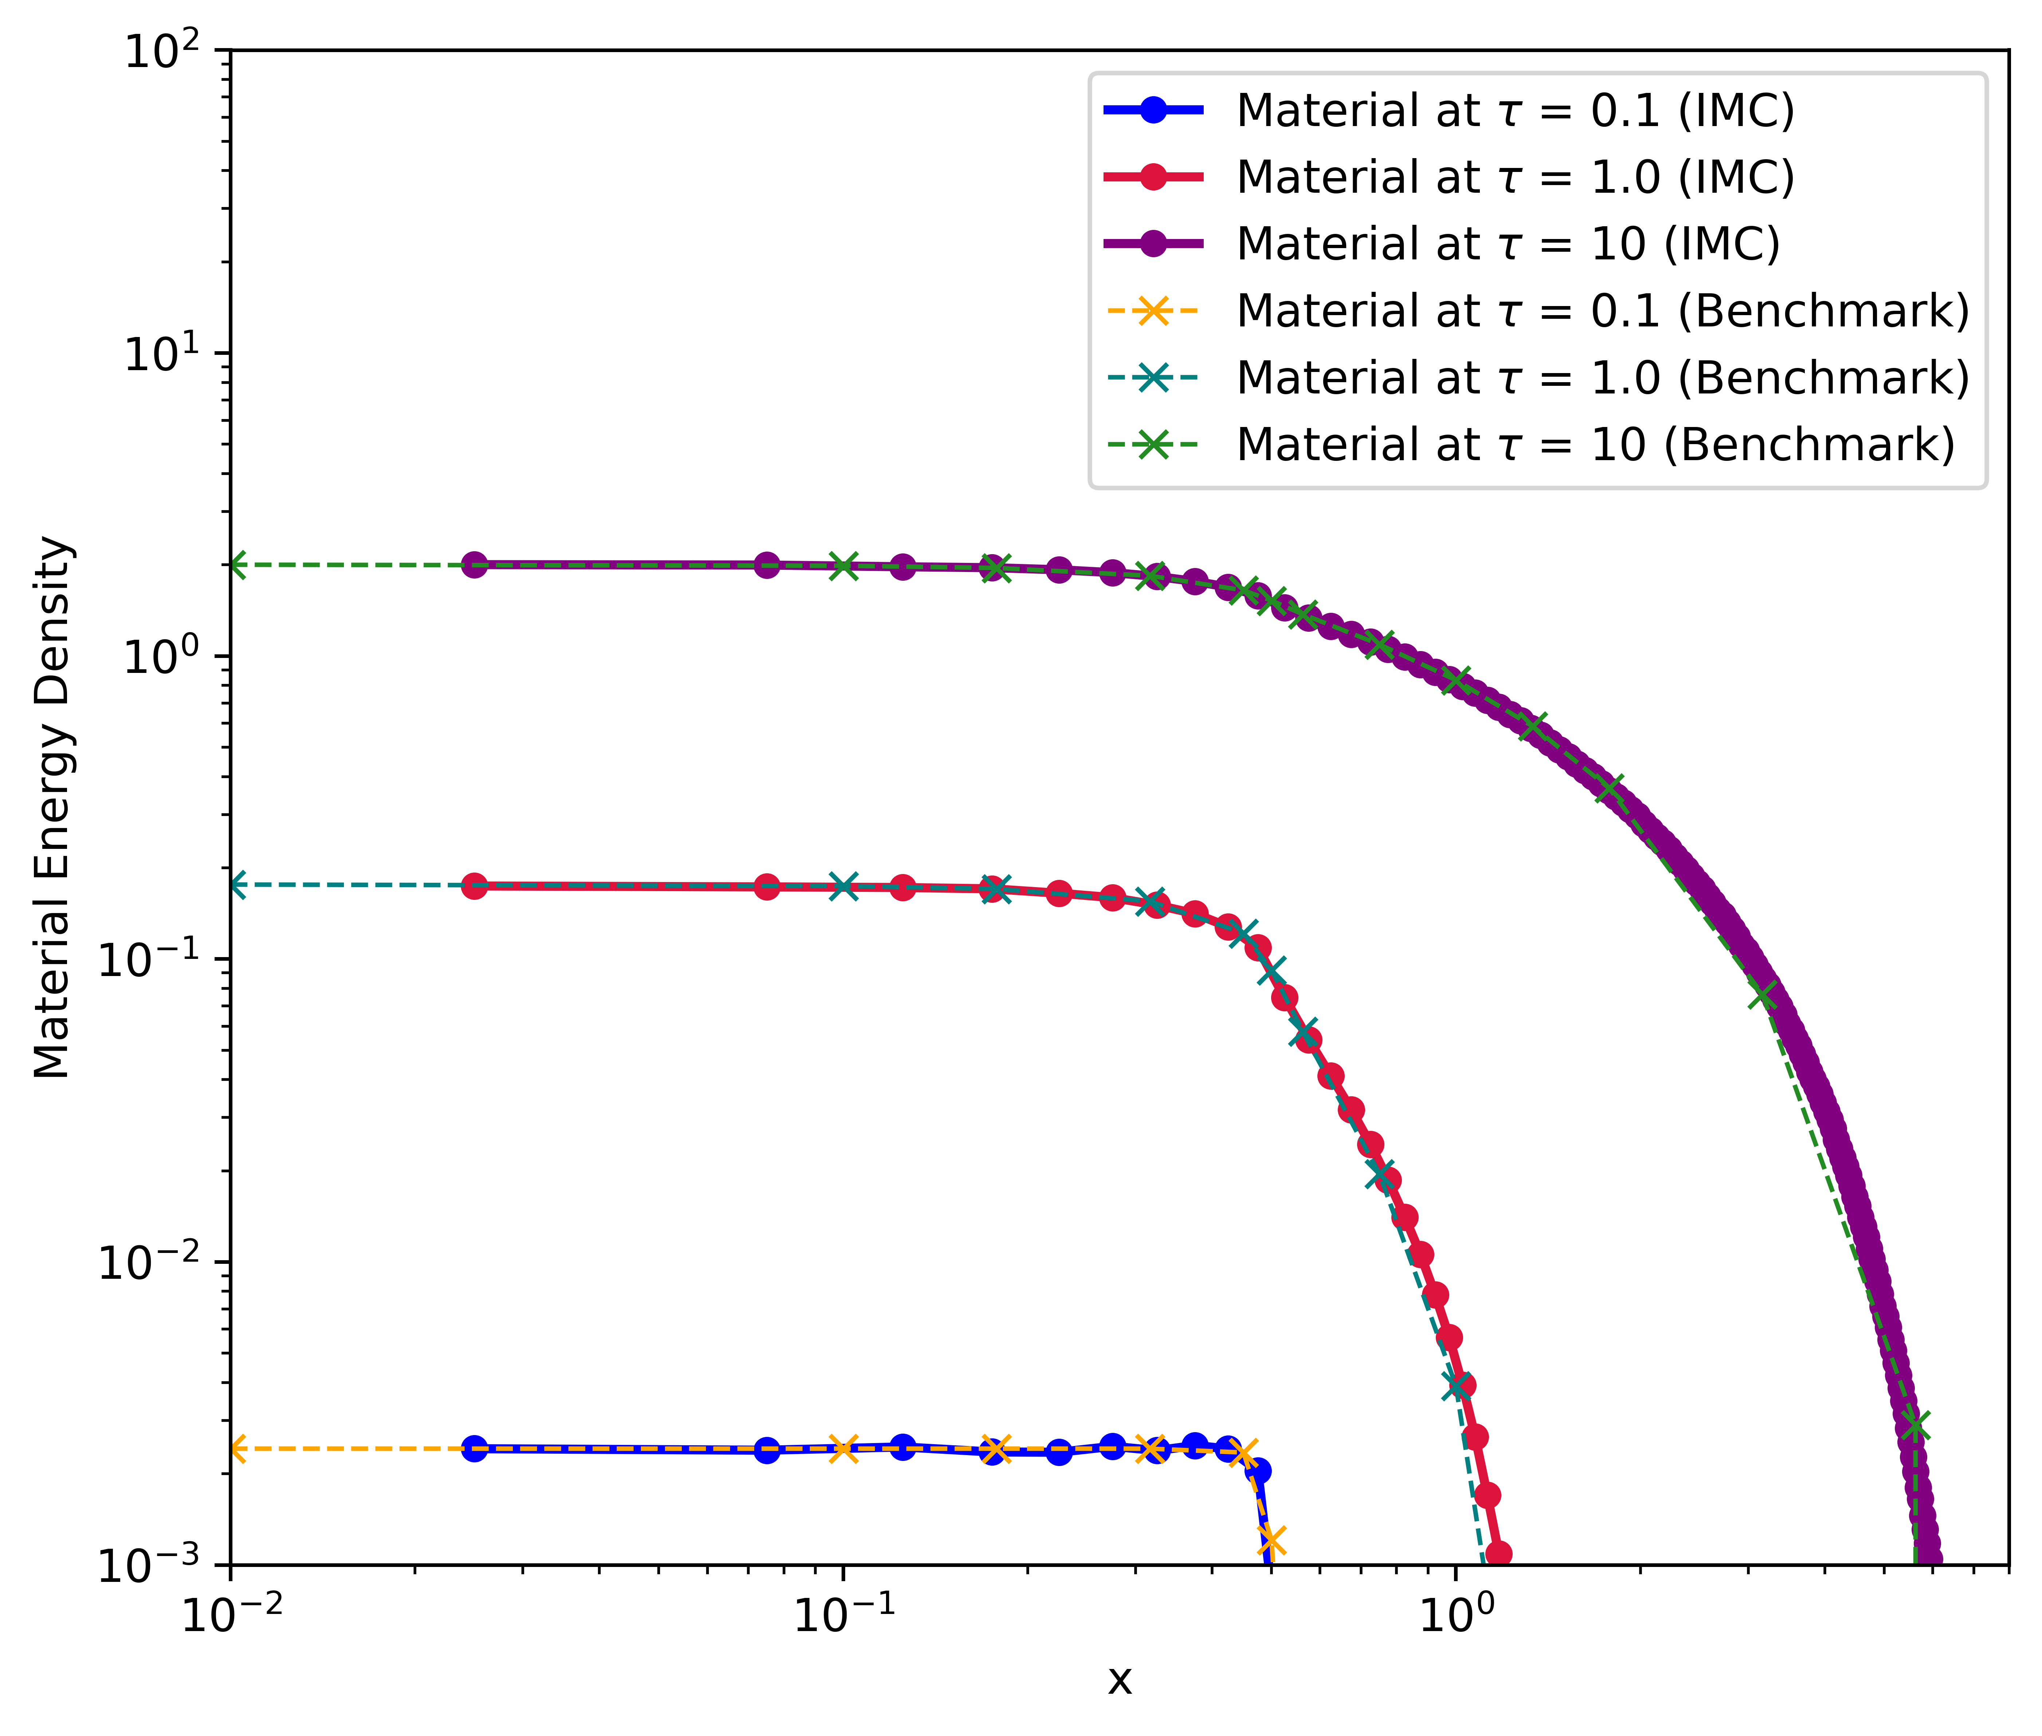
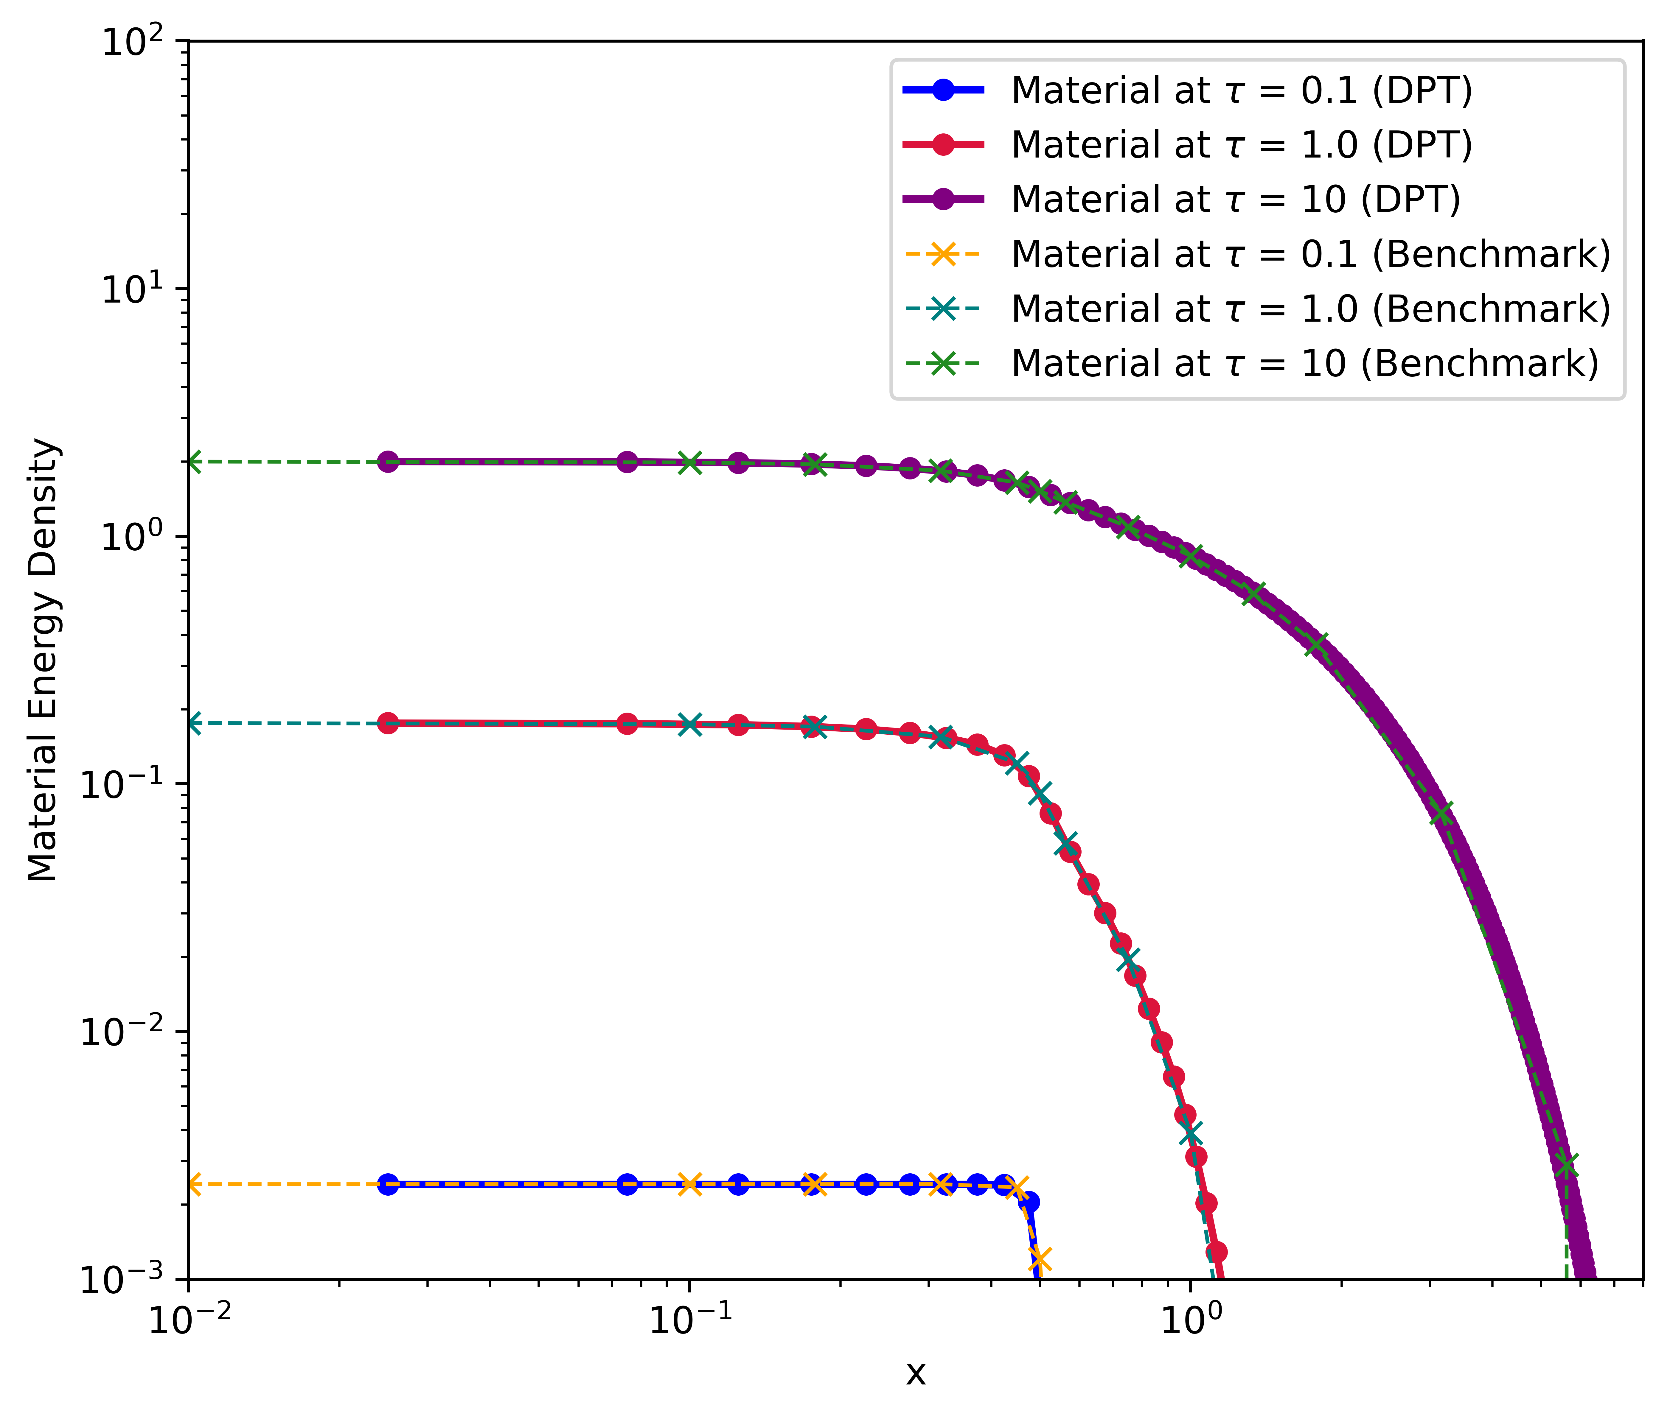
Material Energy Density – IMC vs DPT

Slide 21
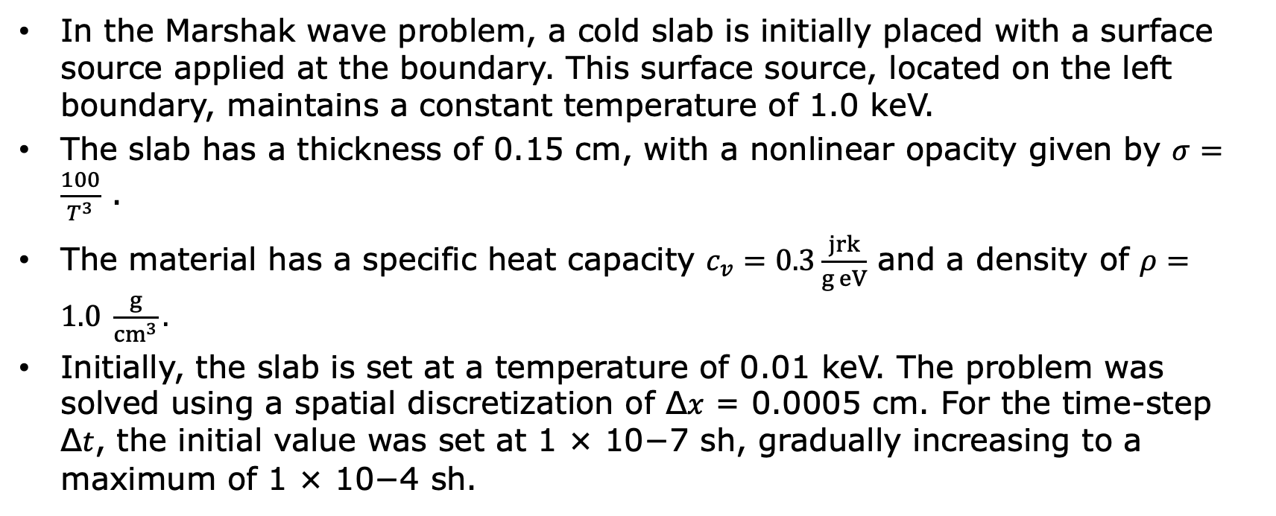
Marshak Wave Problem
In the Marshak wave problem, a cold slab is initially placed with a surface source applied at the boundary. This surface source, located on the left boundary, maintains a constant temperature of 1.0 keV.
The slab has a thickness of 0.15 cm, with a nonlinear opacity given by $σ=\frac{100}{T^{3}}$ .
The material has a specific heat capacity $c_{v}=0.3\frac{jrk}{g eV}$ and a density of $ρ=1.0 \frac{g}{{cm}^{3}}.$
Initially, the slab is set at a temperature of 0.01 keV. The problem was solved using a spatial discretization of Δ𝑥 = 0.0005 cm. For the time-step Δ𝑡, the initial value was set at 1 × 10−7 sh, gradually increasing to a maximum of 1 × 10−4 sh.

Slide 22
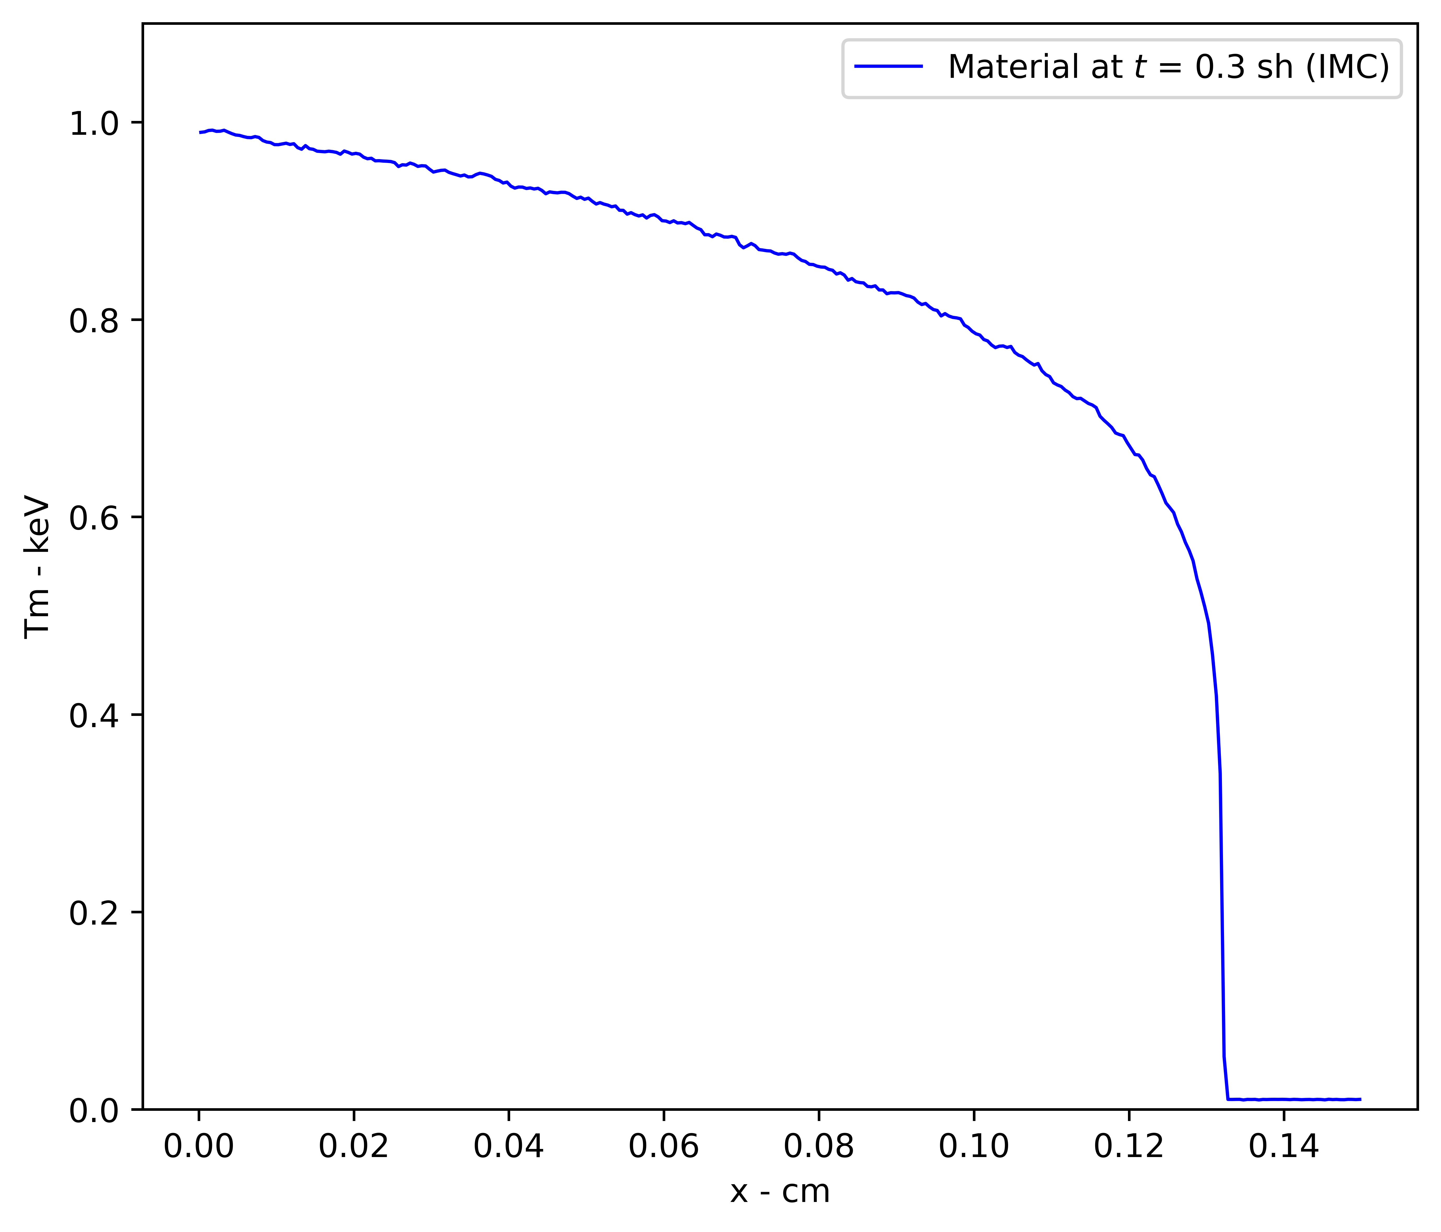
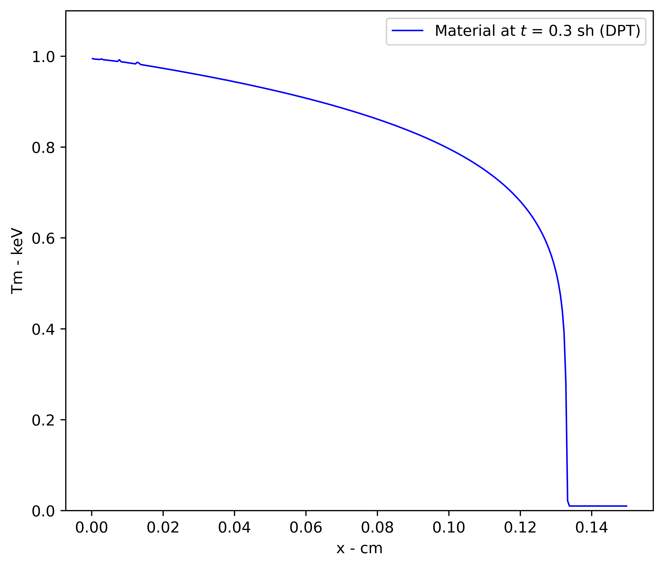
Material Temperature – IMC vs DPT

Slide 23
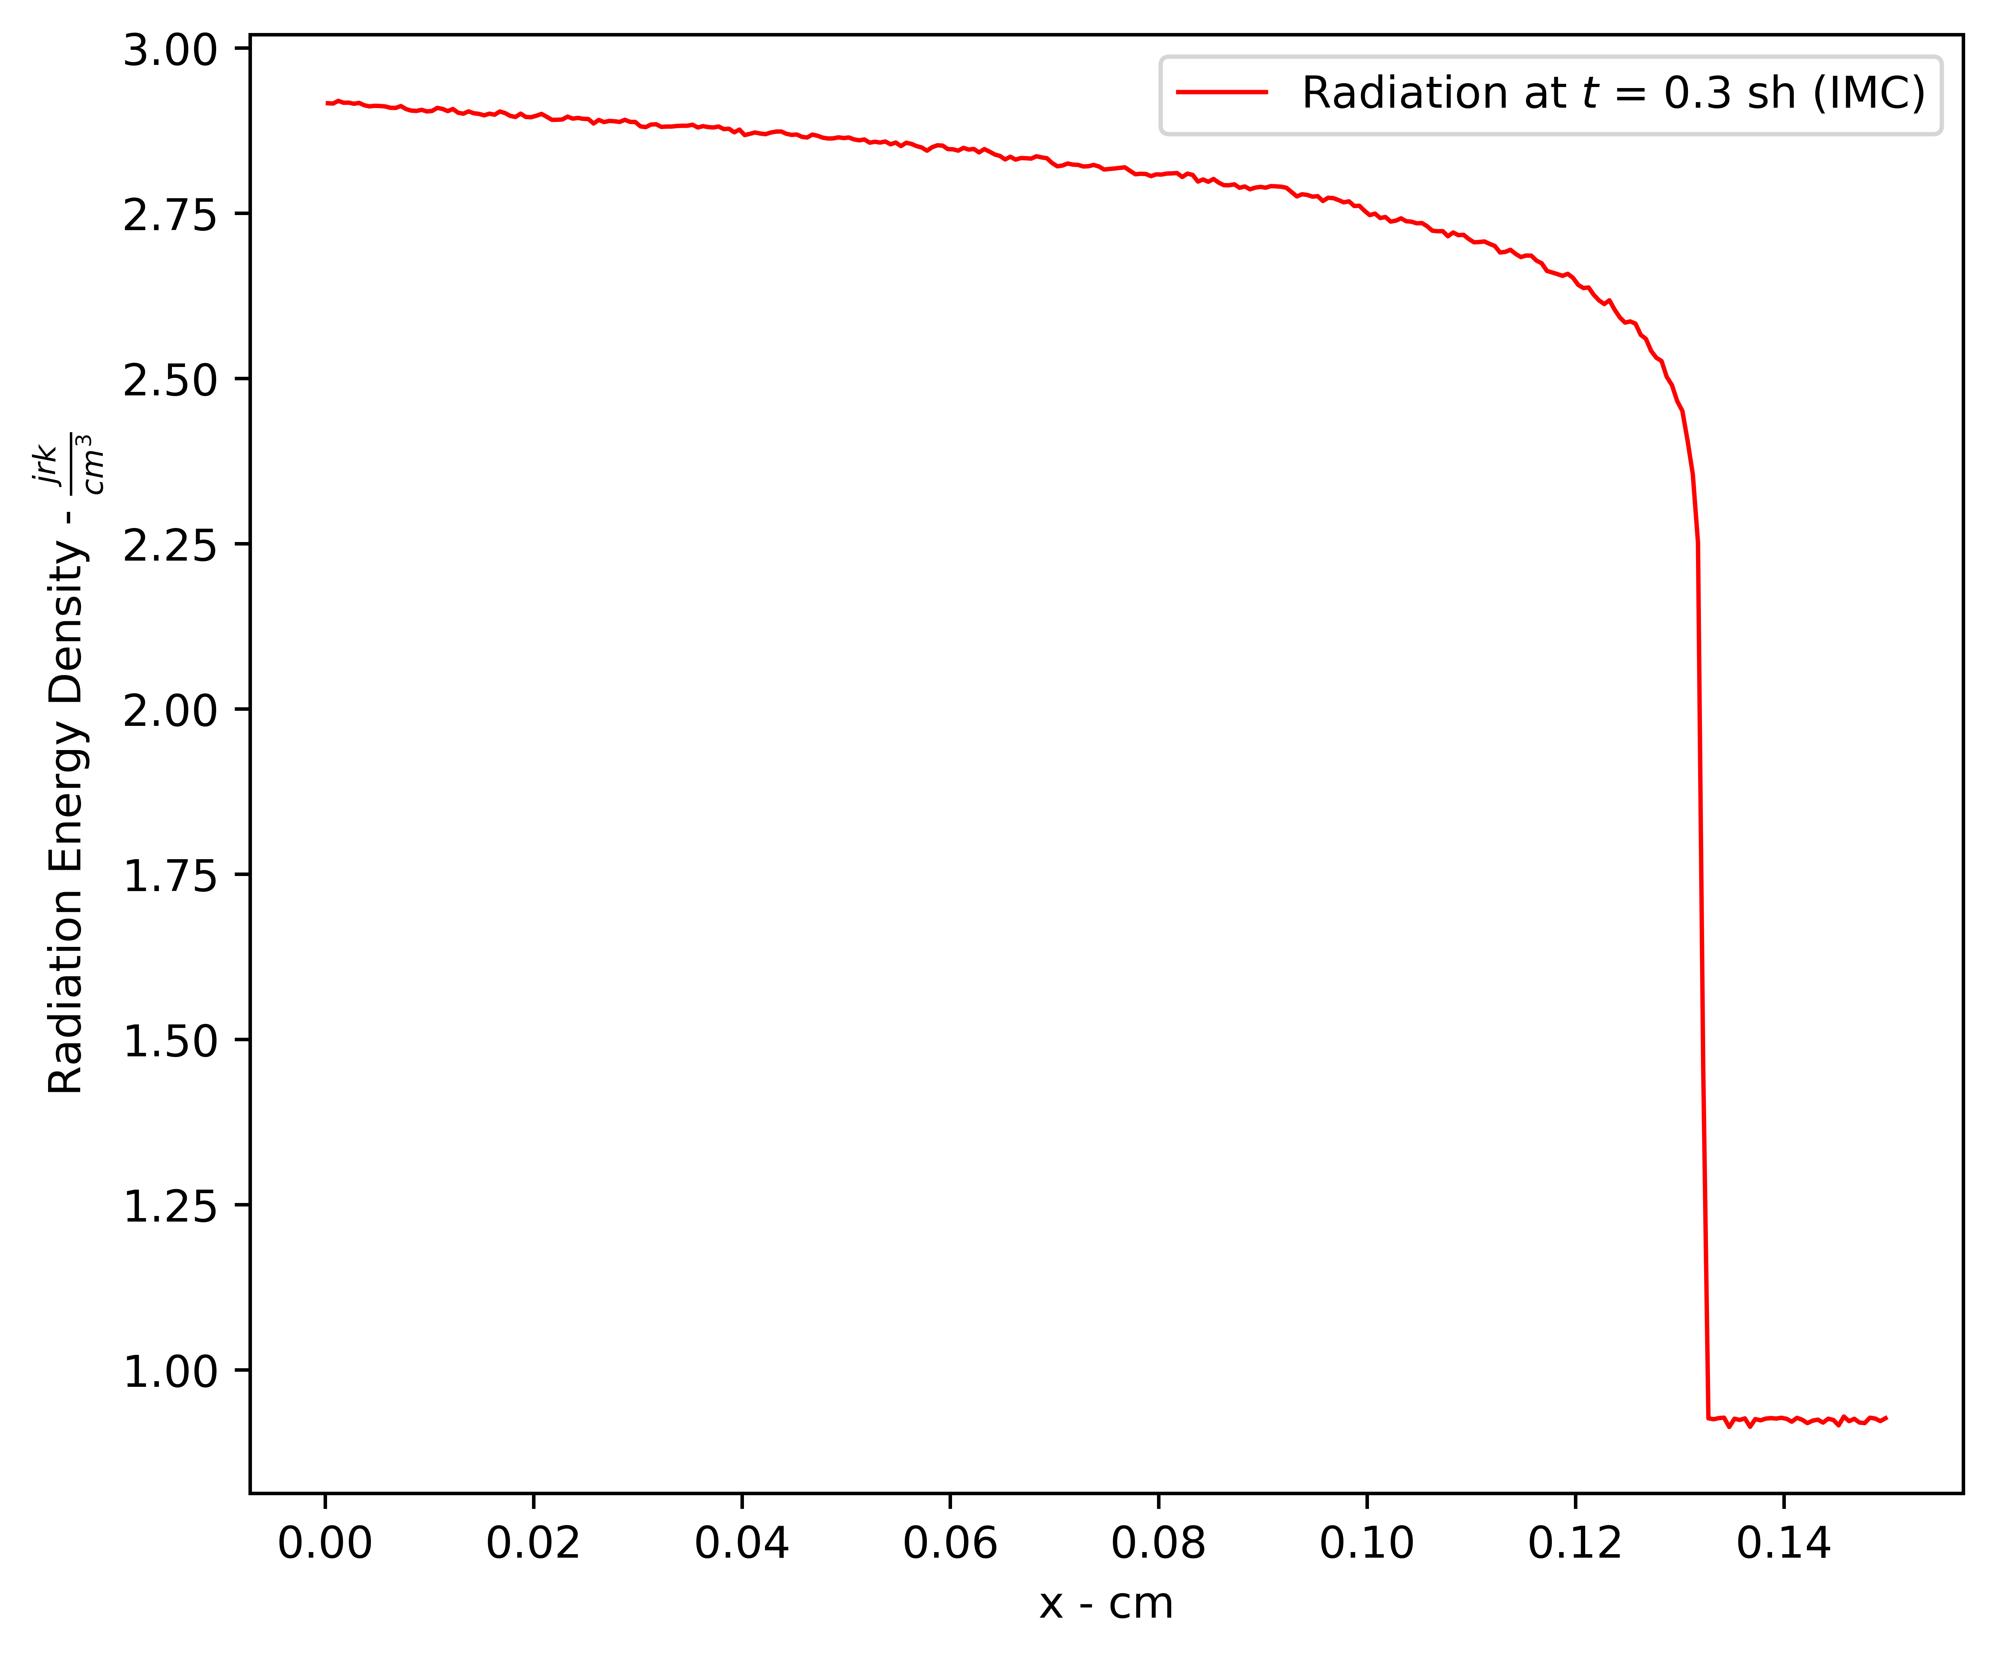
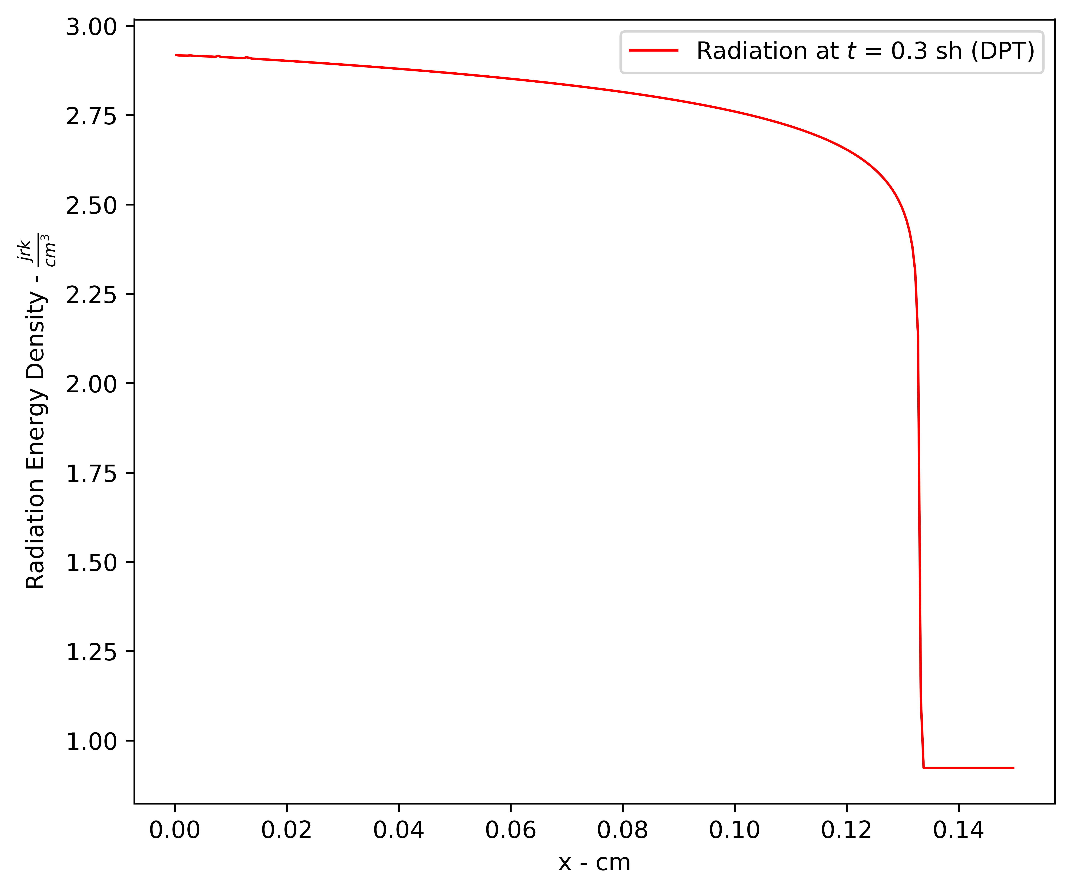
Radiation Energy Density – IMC vs DPT

Slide 24

Marshak Wave Results
For the IMC solution, each time-step used 1 × ${10}^{5}$ source particles. In the DPT solution, particle counts were configured with 𝑁𝑥 = 3, 𝑁𝜇 = 8, and 𝑁𝑡 = 1, resulting in 7204 source particles per time-step. The DPT solution, despite using about 14 times fewer source particles, achieves results that match the IMC solution with less noise.

Slide 25
Future Work
Currently working on a multigroup approach to solve another benchmark problem (Graziani multigroup slab problem).

